Slide 1
CEIS101 Final Project
MAY24
Jonathen Weidman
Prof. Jose Rodriguez

Slide 2
Introduction
In this project I was taught how different aspects of IoT devices work together.
This project I built a home automation IoT device. This device taught me how different sensors work and communicate with the rest of the device.
I was able to program the device using the Arduino software to make it do the tasks I needed it to. I learned how to automate tasks using the Arduino circuit board.
I used a combination of LED, distance sensor, photocell, resistors, and an active buzzer to accomplish the tasks the project required.
I was expected to make the green LED stay on while there is nothing close to the ultrasonic sensor then as an object moves closer it sends a warning signal causing a slow beep from the active buzzer and turning on the yellow LED with the green LED off. Then when the object was to close to the sensor it would turn on only the red LED and the buzzer will rapidly beep.
The other task was to get the blue LED to turn off when the photocell detected light above a certain level. All these tasks can go together in a real-life scenario when leaving the house having an emergency light on when you turn the lights out and a security sensor to detect a possible intruder.

Slide 3
Module 2 Overview
In this portion of the project, I was practicing and trying to get the hang of the Arduino software and learning how to put the project together using the Tinkercad website.
I was also introduced to programming the code to accomplish all different tasks required in the future of this project.

Slide 4
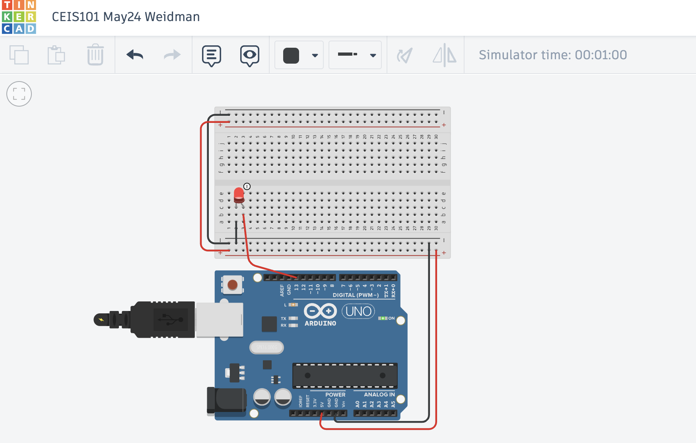
Circuit (screenshot)

Slide 5
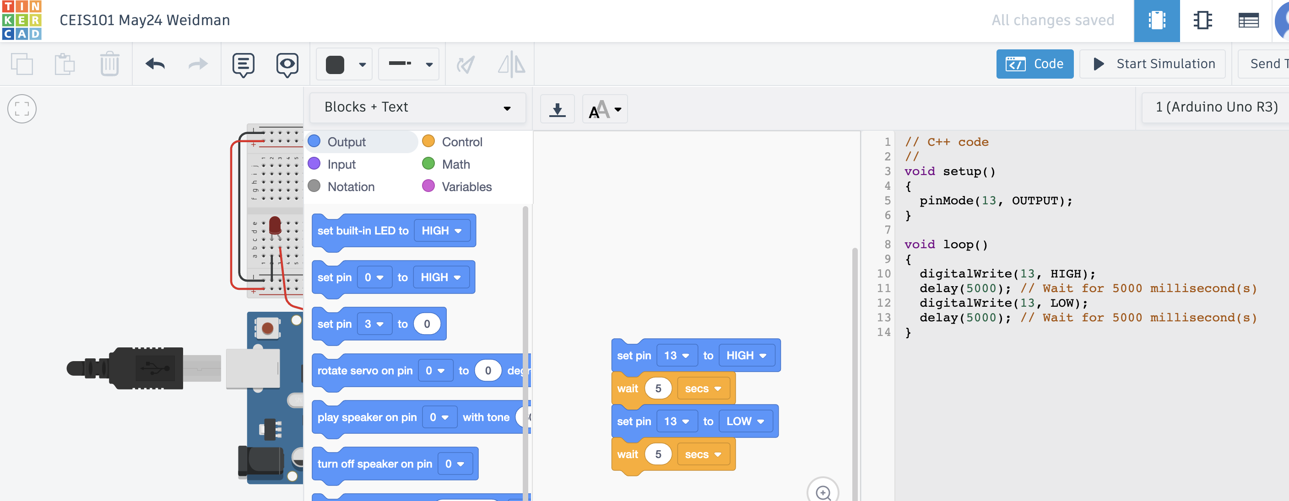
Code (screenshot)

Slide 6
Module 3 Overview
This part of the project, I took inventory of everything I had received in my IoT kit and split the items I used for this project from everything else.
I had started the build of the project on the breadboard and the circuit board. In this part I made a red LED that would blink on and off when everything was wired properly.
I show at the end of this module the code that I typed out in the Arduino software and the serial monitor showing the process of the LED blinking along with my name and the course.

Slide 7
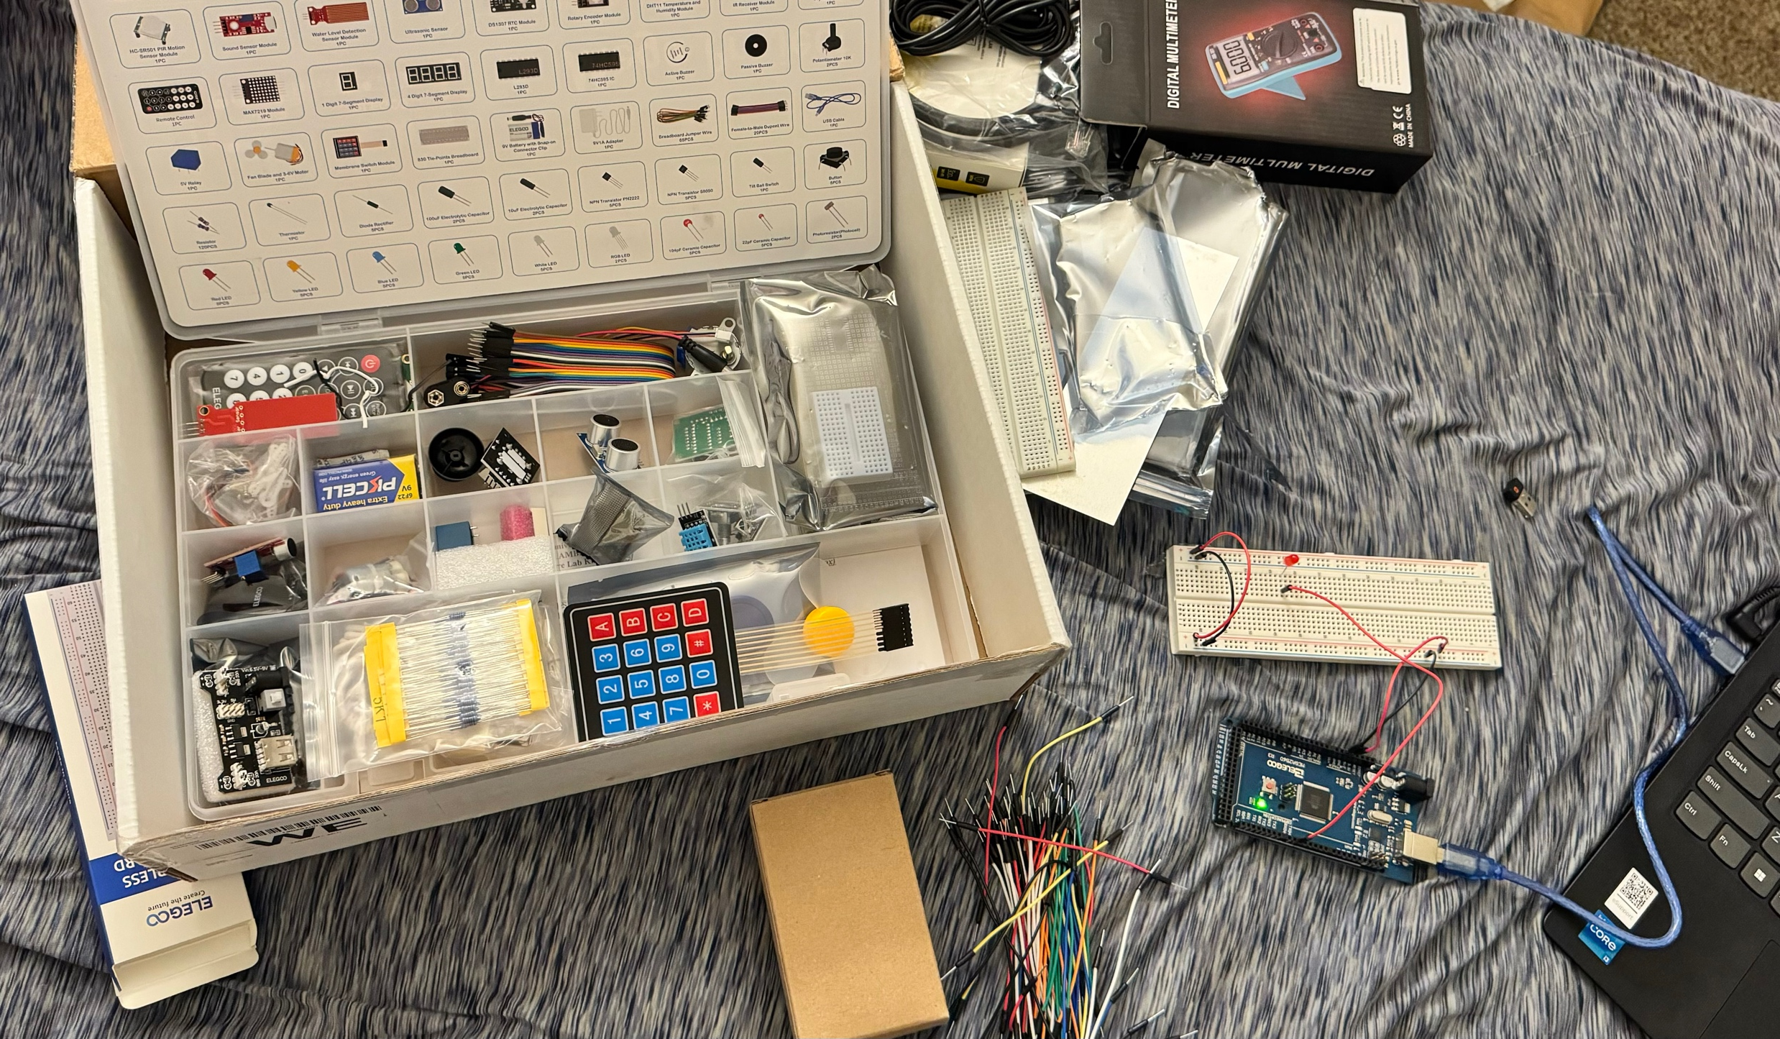
Inventory of IoT Kit (picture)
UCTRONICS Kit
ESP32 (2)
LCD Modules (2)
Breadboards (3)
Mini Router
Patch Cable
Digital Multi Meter
USB to Micro USB (2)

Slide 8
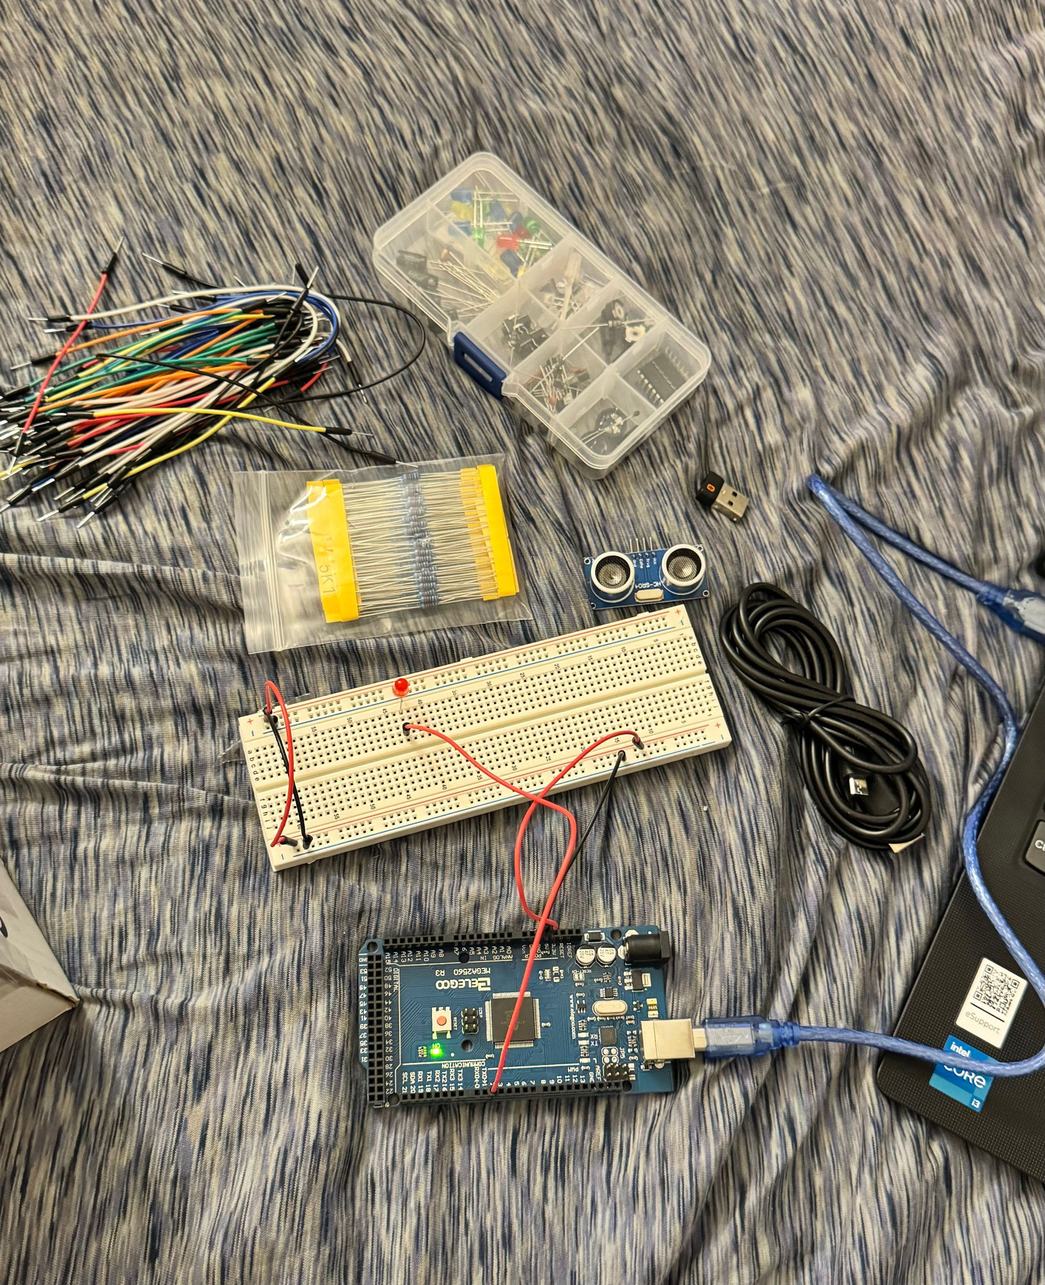
Organization of Project Components (picture)
Arduino Mega 2560
Breadboard
Resistor 10kΩ
LEDs
Ultrasonic Sensor
Active Buzzer
Photoresistor
Wires
USB Type B cable

Slide 9
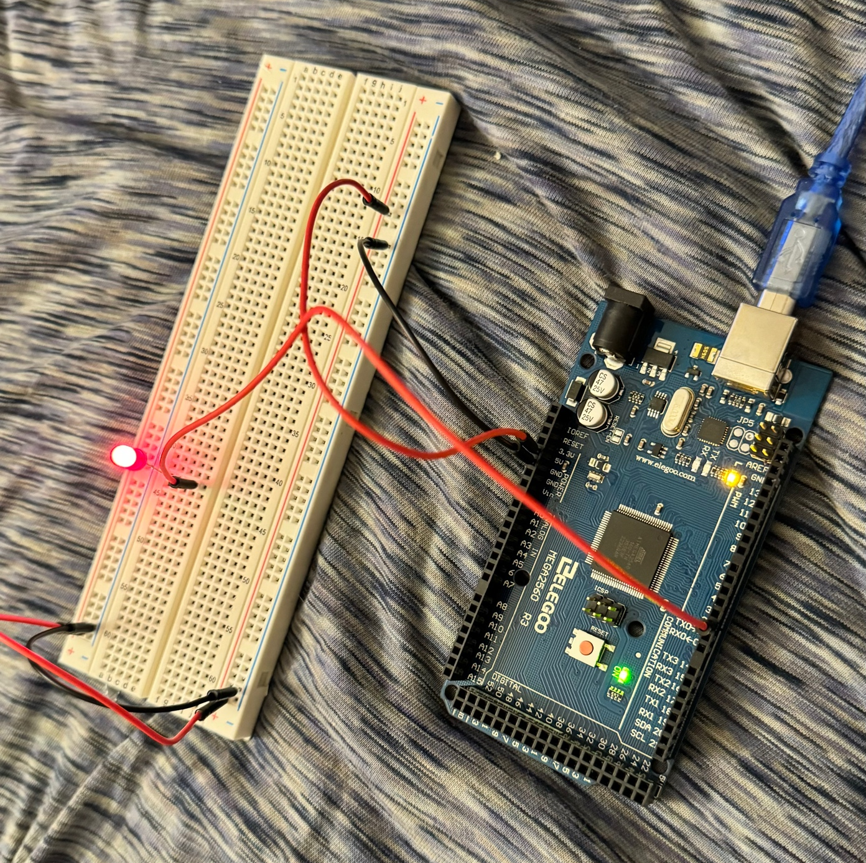
Circuit with red LED on (picture)

Slide 10
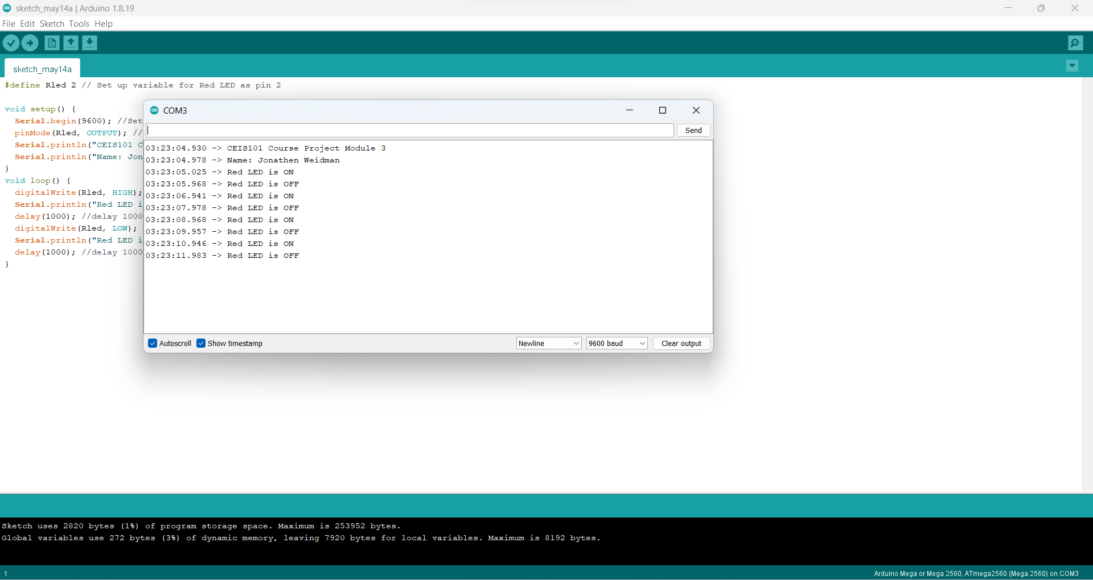
Serial Monitor (screenshot)

Slide 11
Module 4 Overview
On this week of the project, I added a green LED alongside the red LED and an active buzzer to the breadboard. You will also notice there is an extra wire connected.
This part of the project started to introduce us to the security aspect. The blue wire connected is the door sensor for this portion. When connected it symbolizes a closed door and when disconnected it displays the red LED and activates the buzzer.
All these events that occur are displayed in the serial monitor to show the security warning.

Slide 12
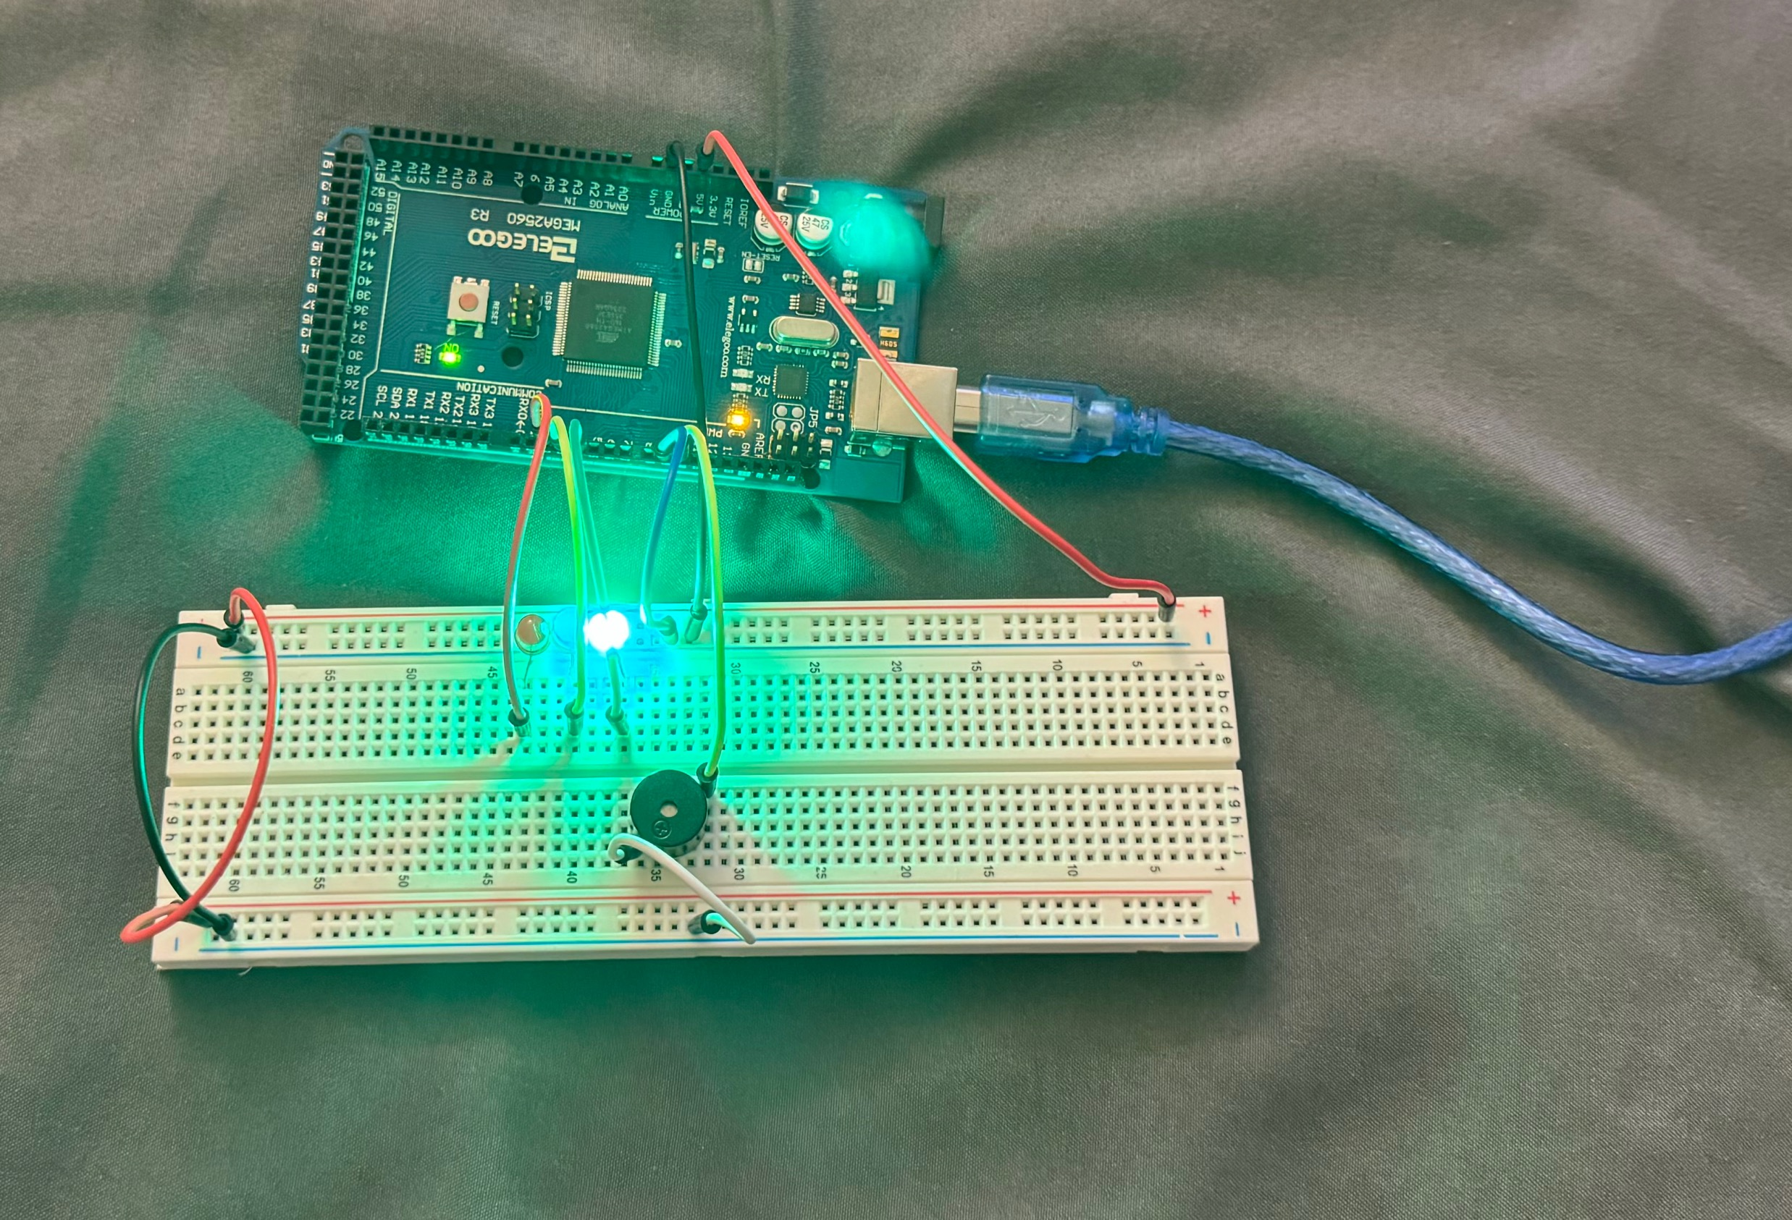
Circuit of door closed with Green LED ON (picture)

Slide 13
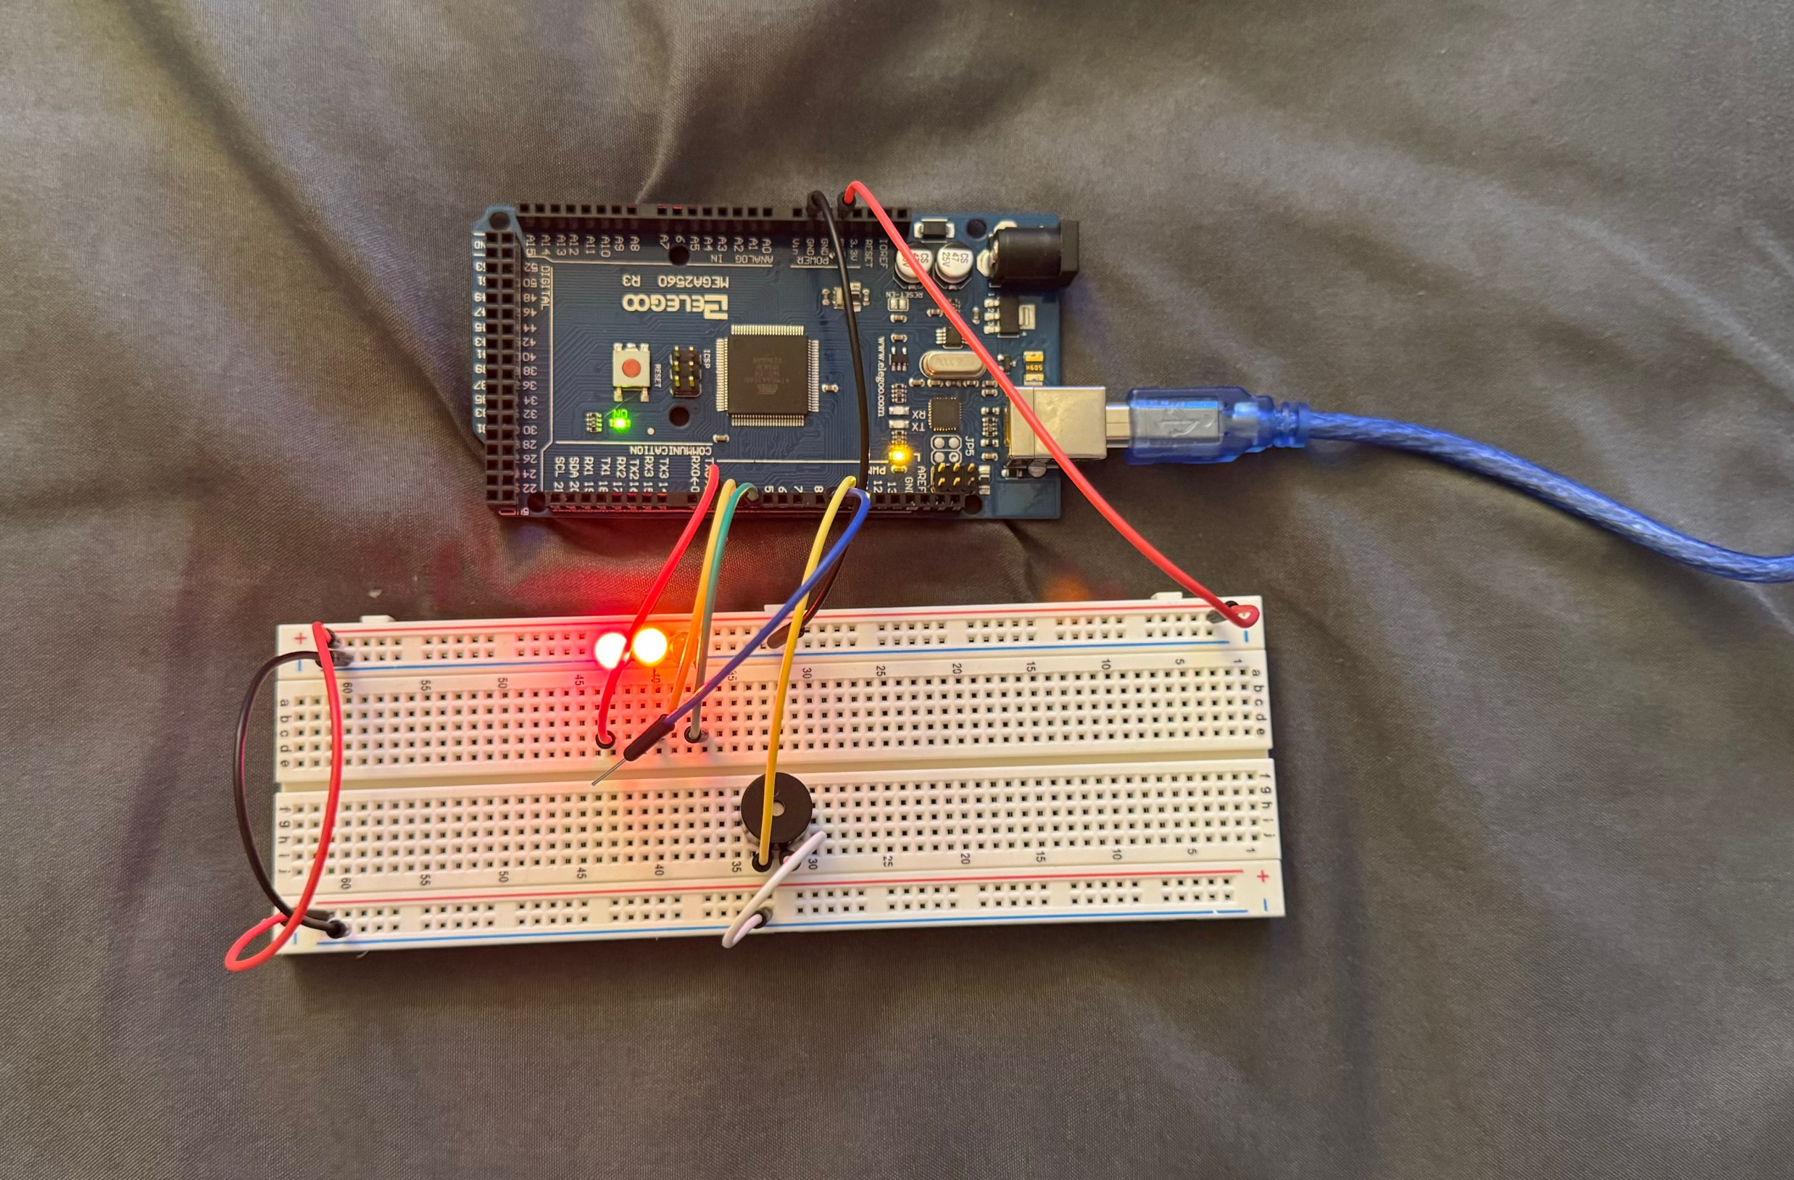
Circuit of door open with Green LED OFF (picture)

Slide 14
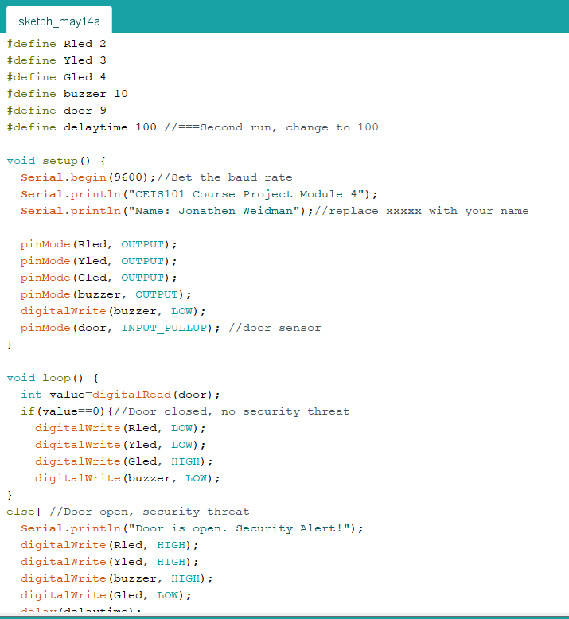
Arduino Code (screenshot)

Slide 15
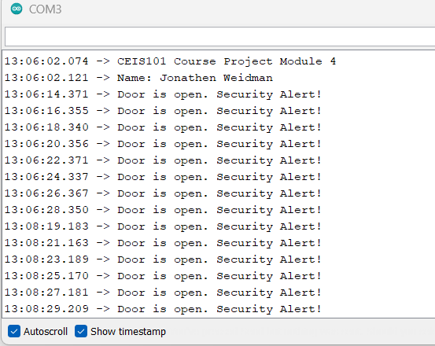
Serial Monitor (screenshot)

Slide 16
Module 5 Overview
Here I took out the blue wire from the last module that was acting as the door sensor and instead replaced with the ultrasonic sensor. I also added a yellow LED to show as a warning instead of safe and danger only.
When the ultrasonic sensor does not detect anything within range the green LED will stay active. Then, once an object gets closer to range the yellow LED will turn on only and the active buzzer will start slowly beeping. Once the object gets to close to the ultrasonic sensor the buzzer will start beeping rapidly and only the red LED will be on.
In the serial monitor, you can see the distance changing as the object gets closer to the ultrasonic sensor and gets further away. I also provide a graph to show the change of the distance from the ultrasonic sensor.

Slide 17
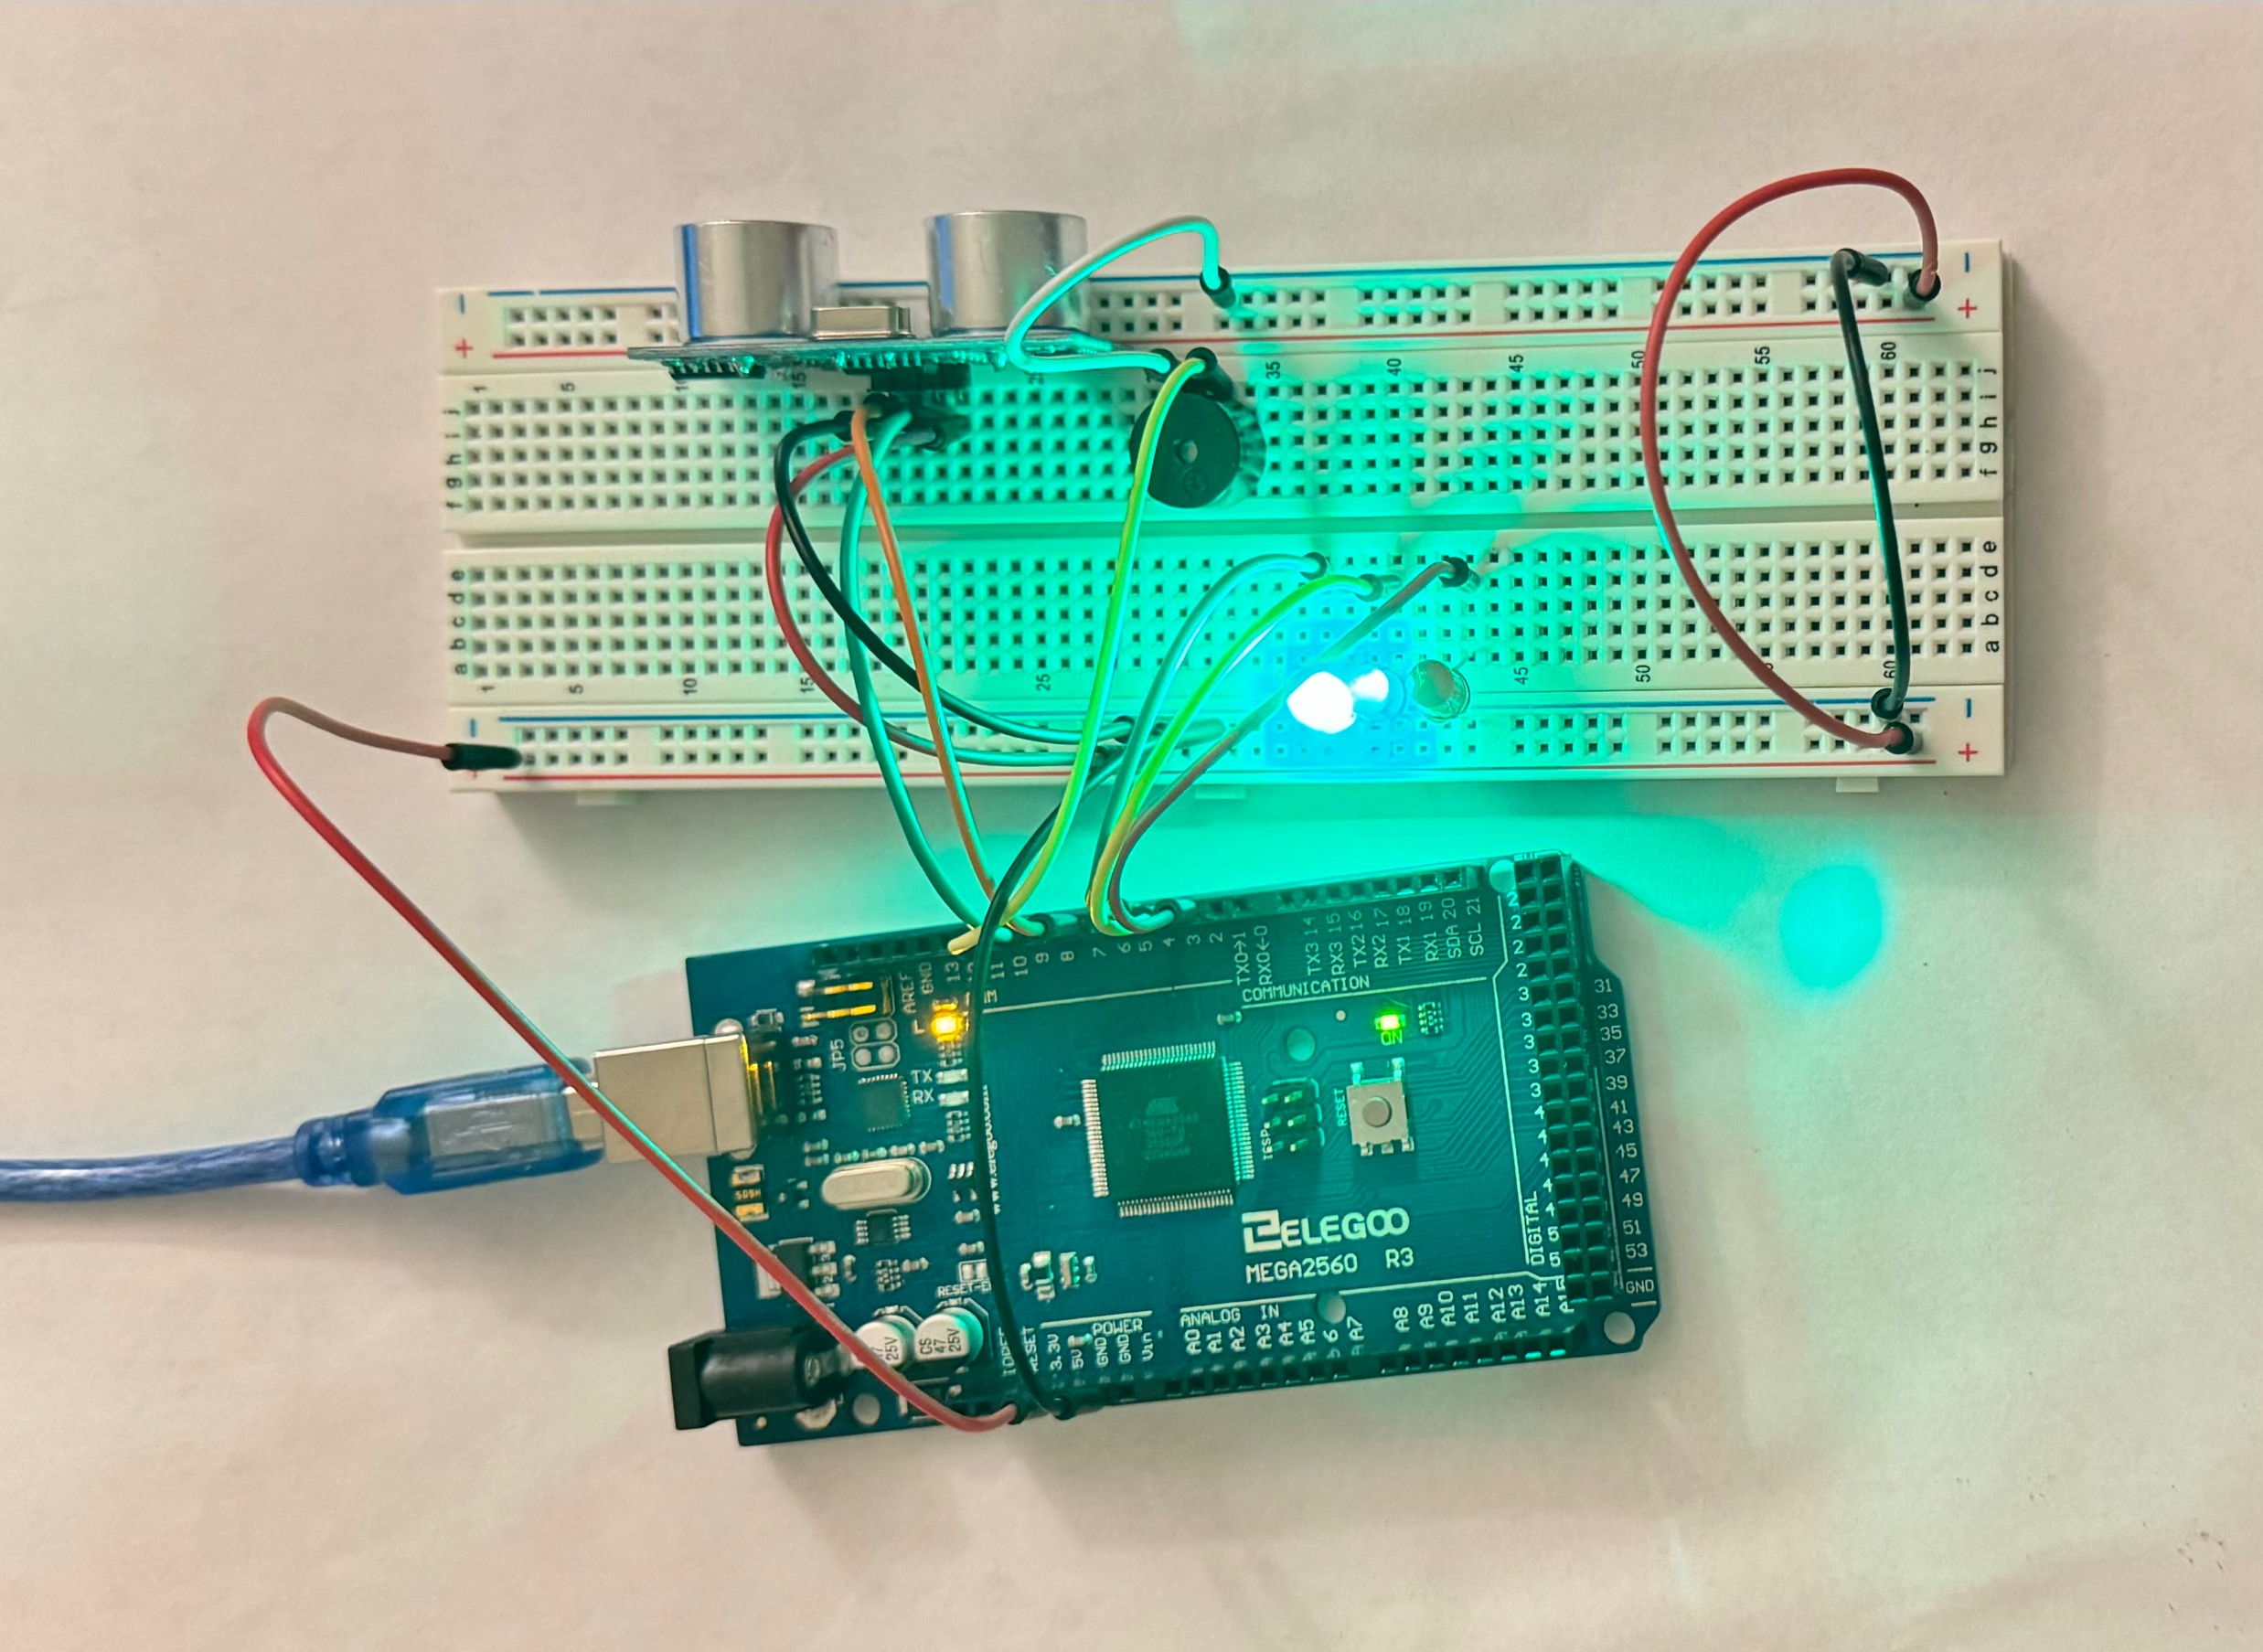
Circuit with green LED on (picture)

Slide 18
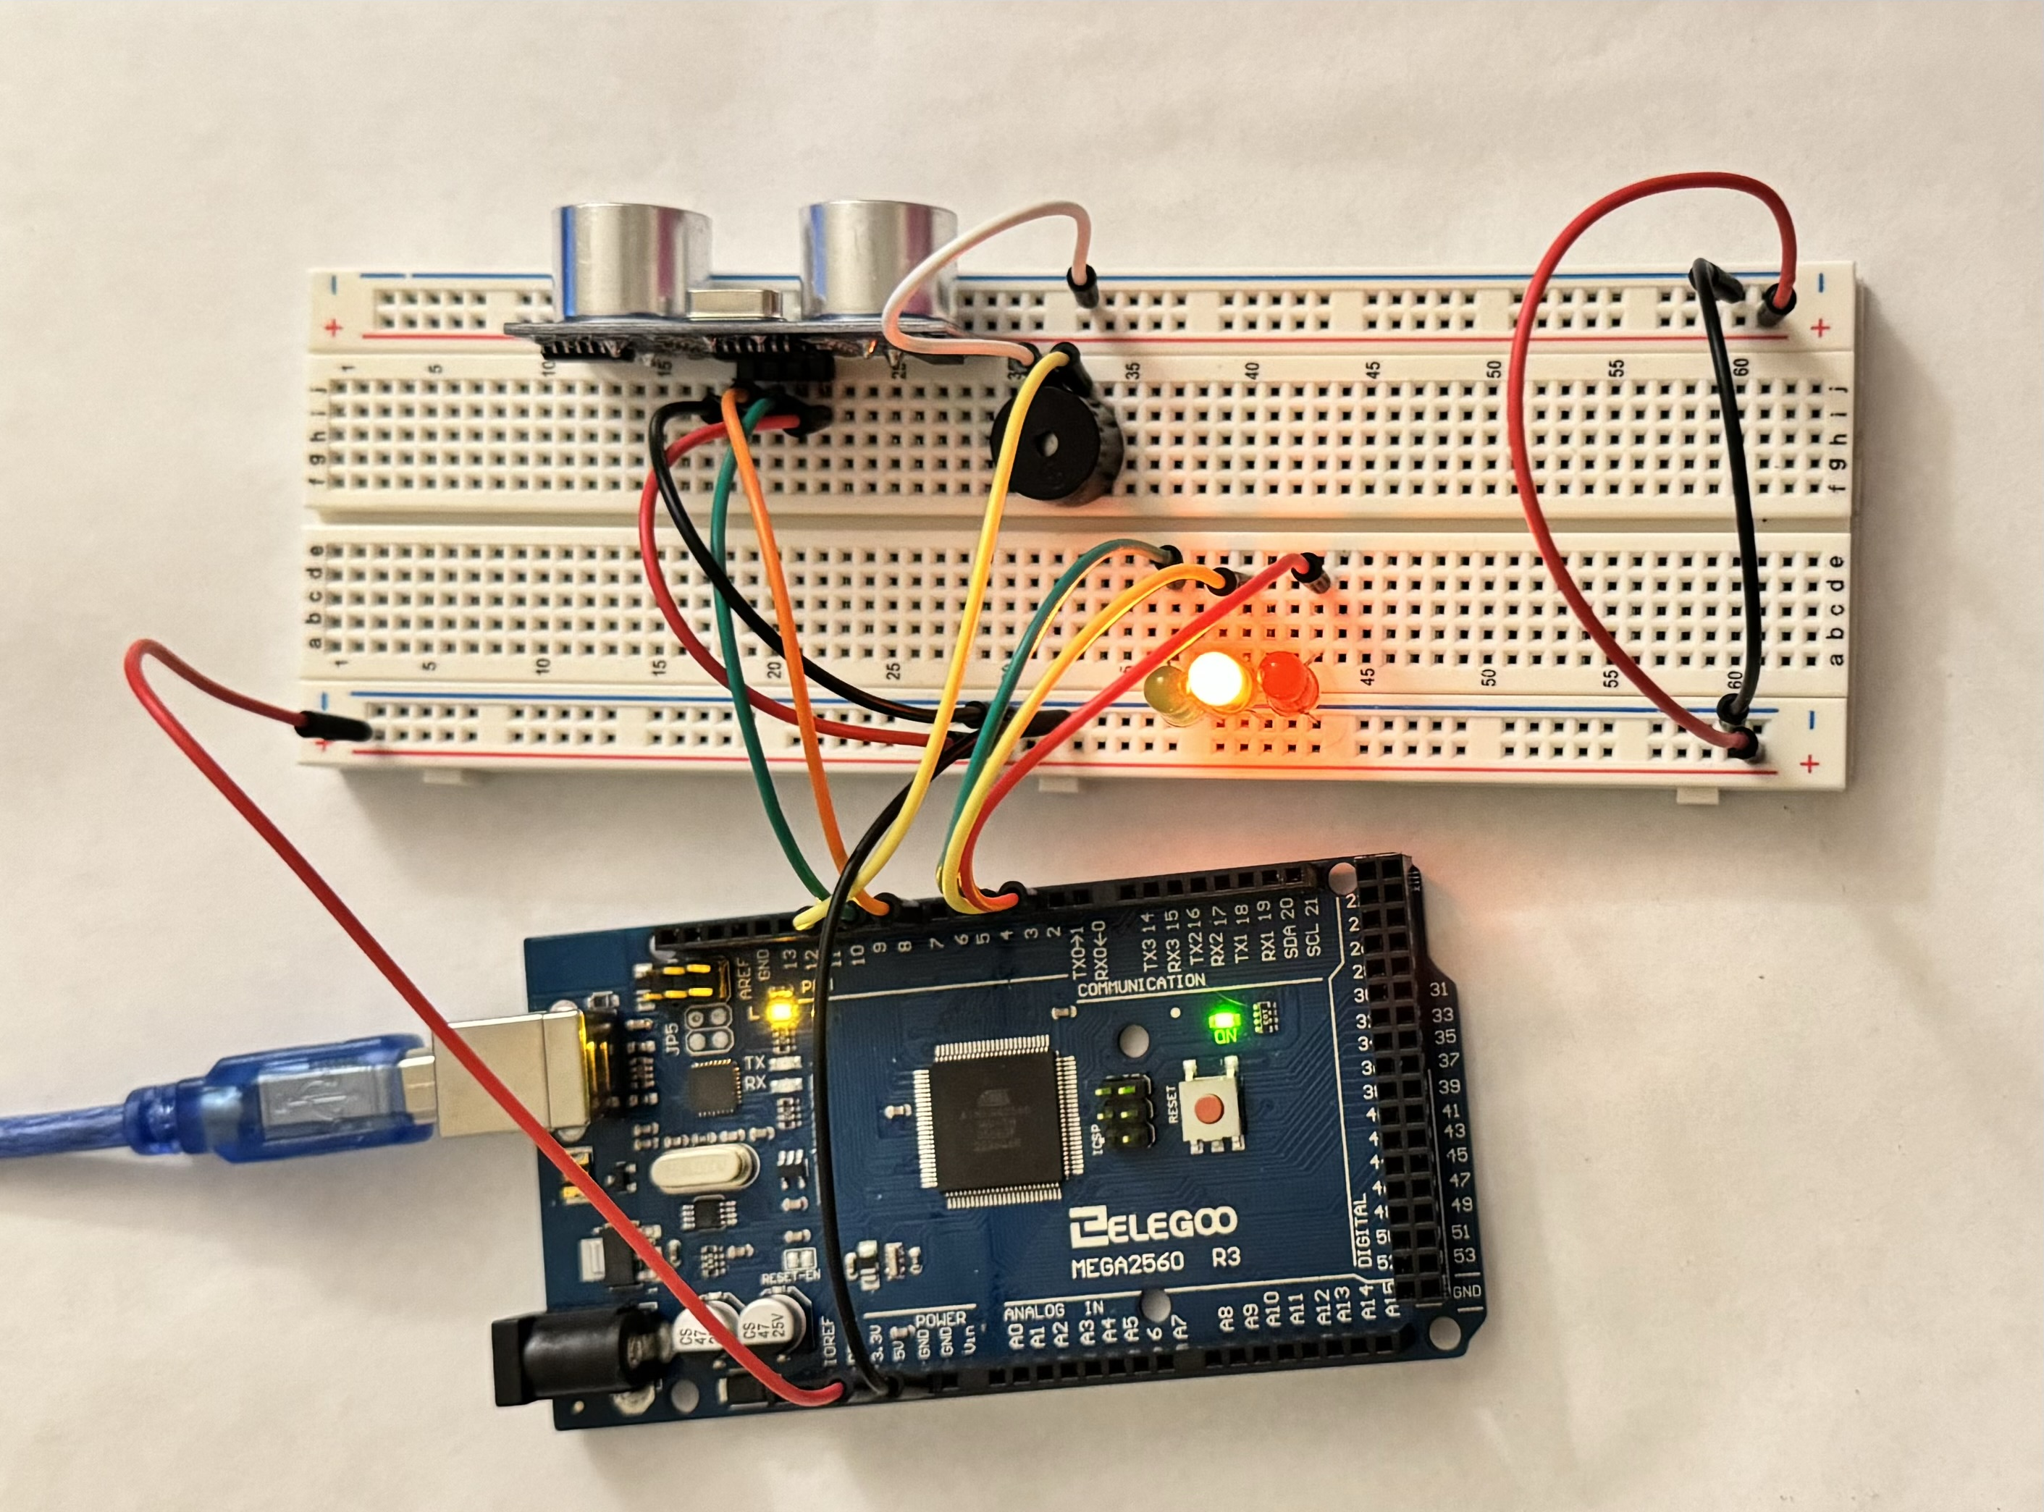
Circuit with yellow LED on (picture)

Slide 19
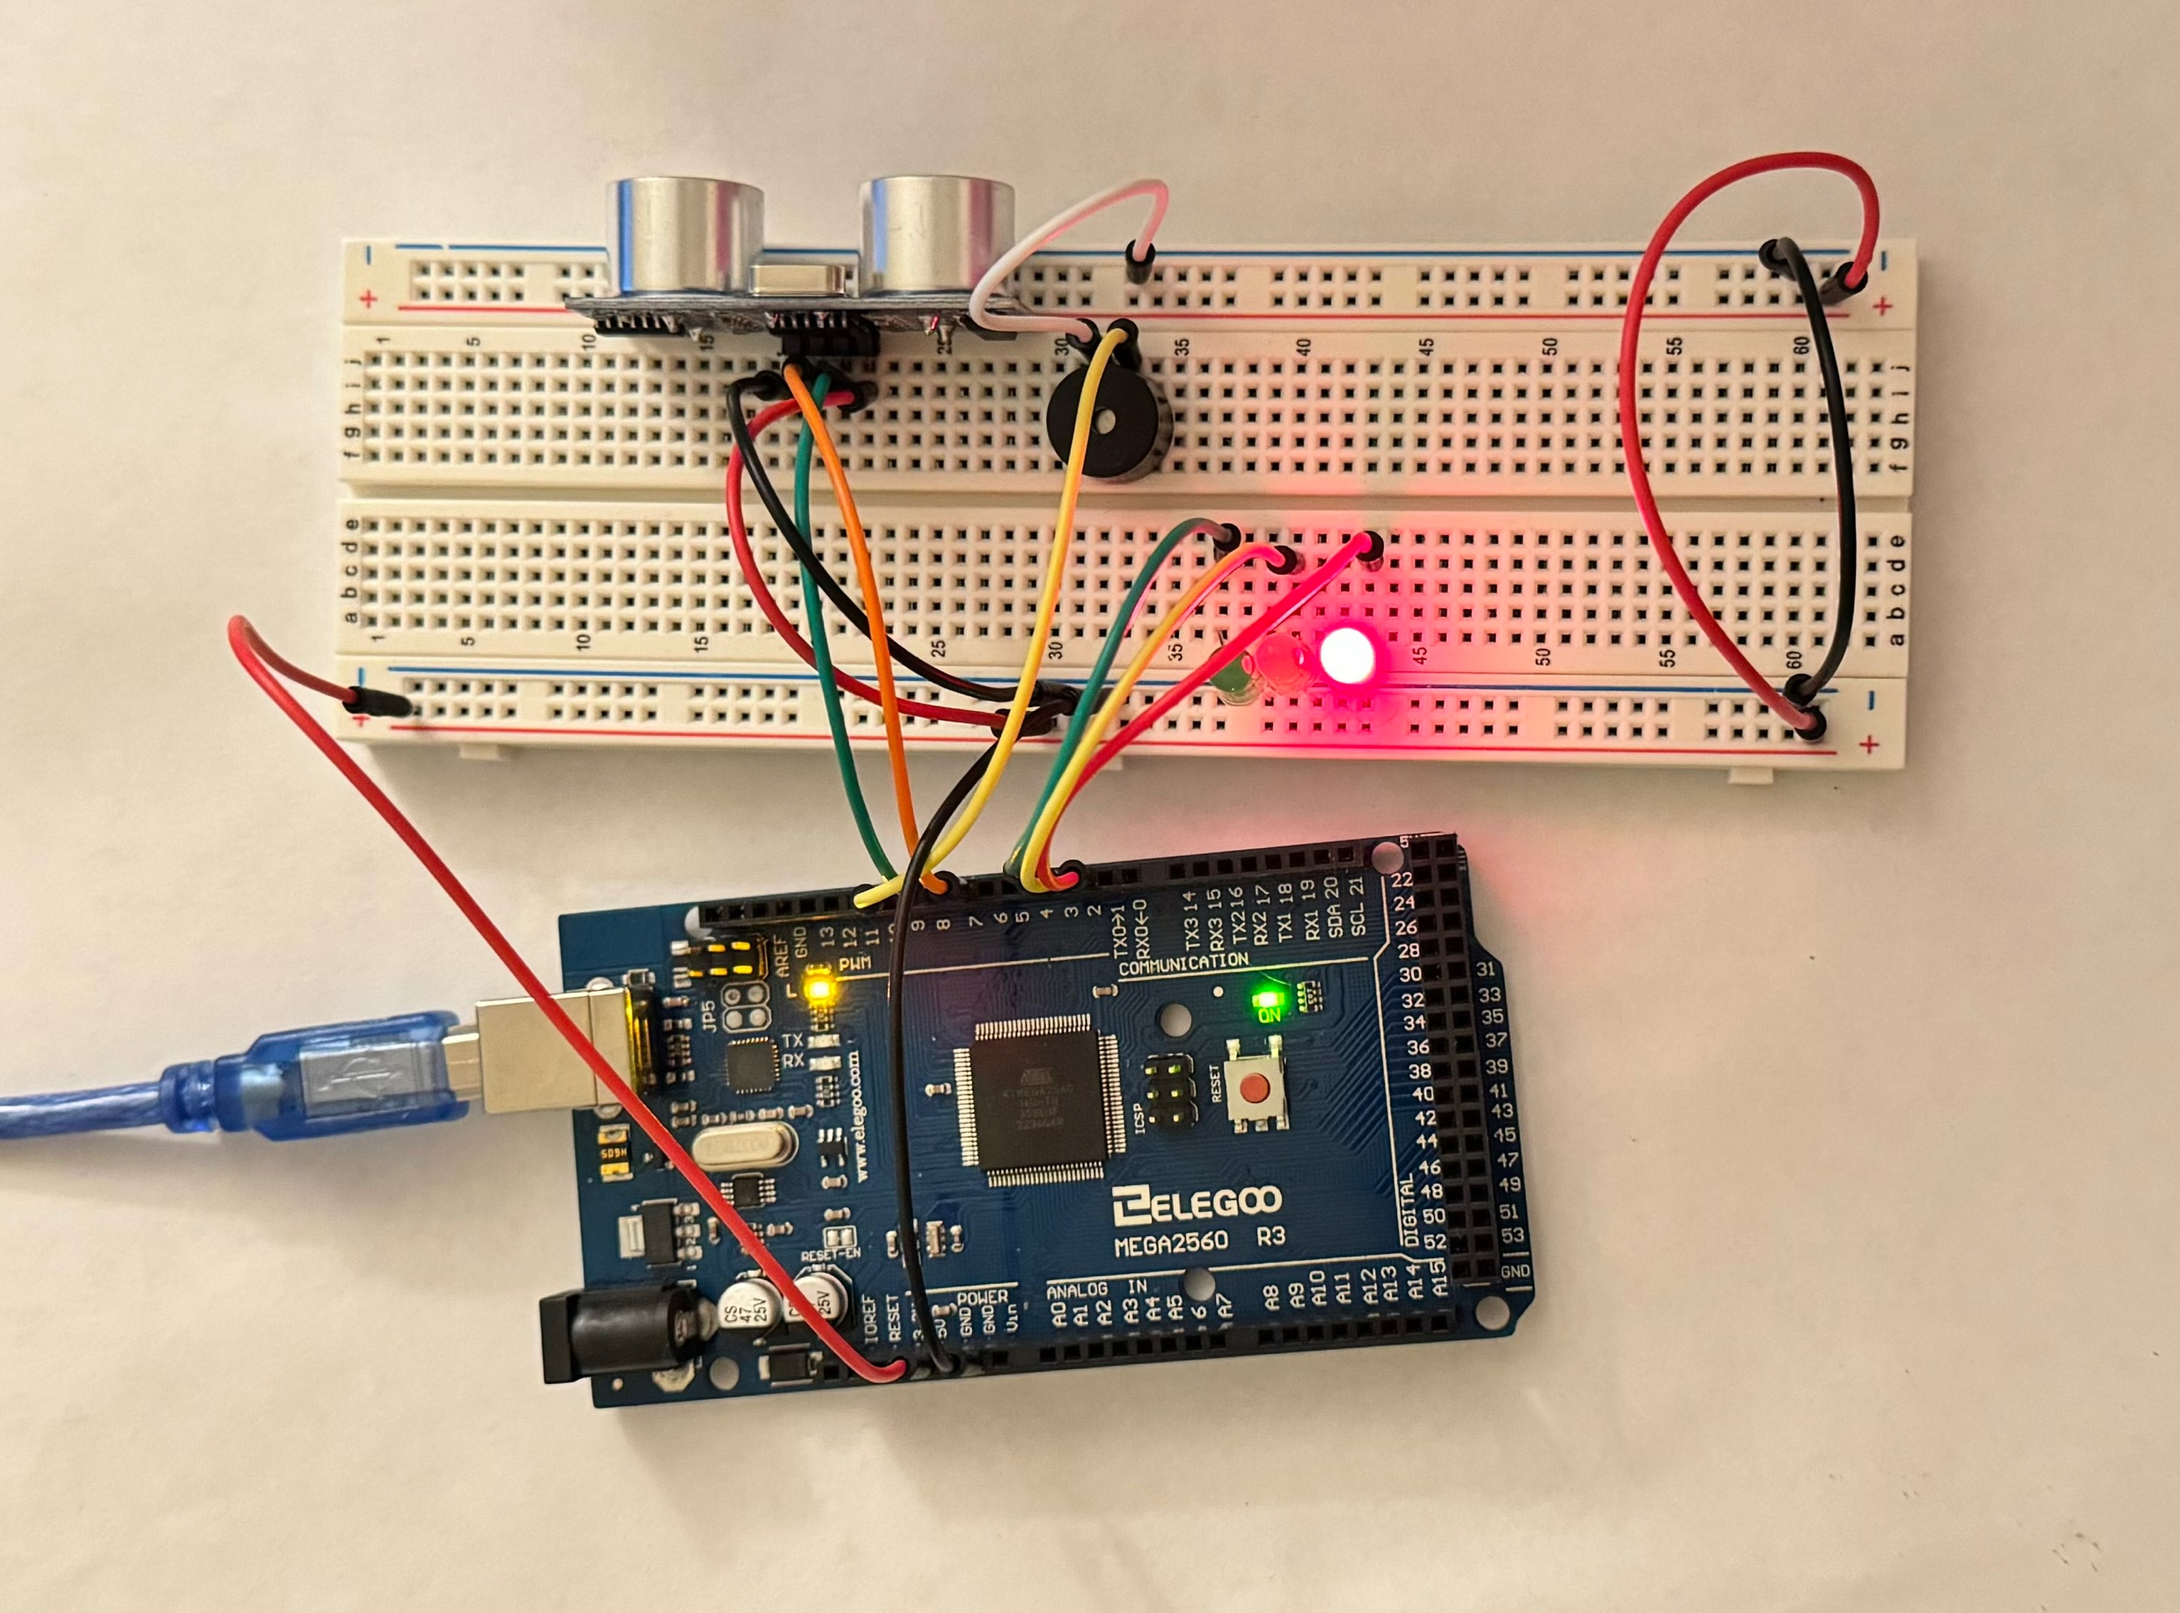
Circuit with red LED on (picture)

Slide 20
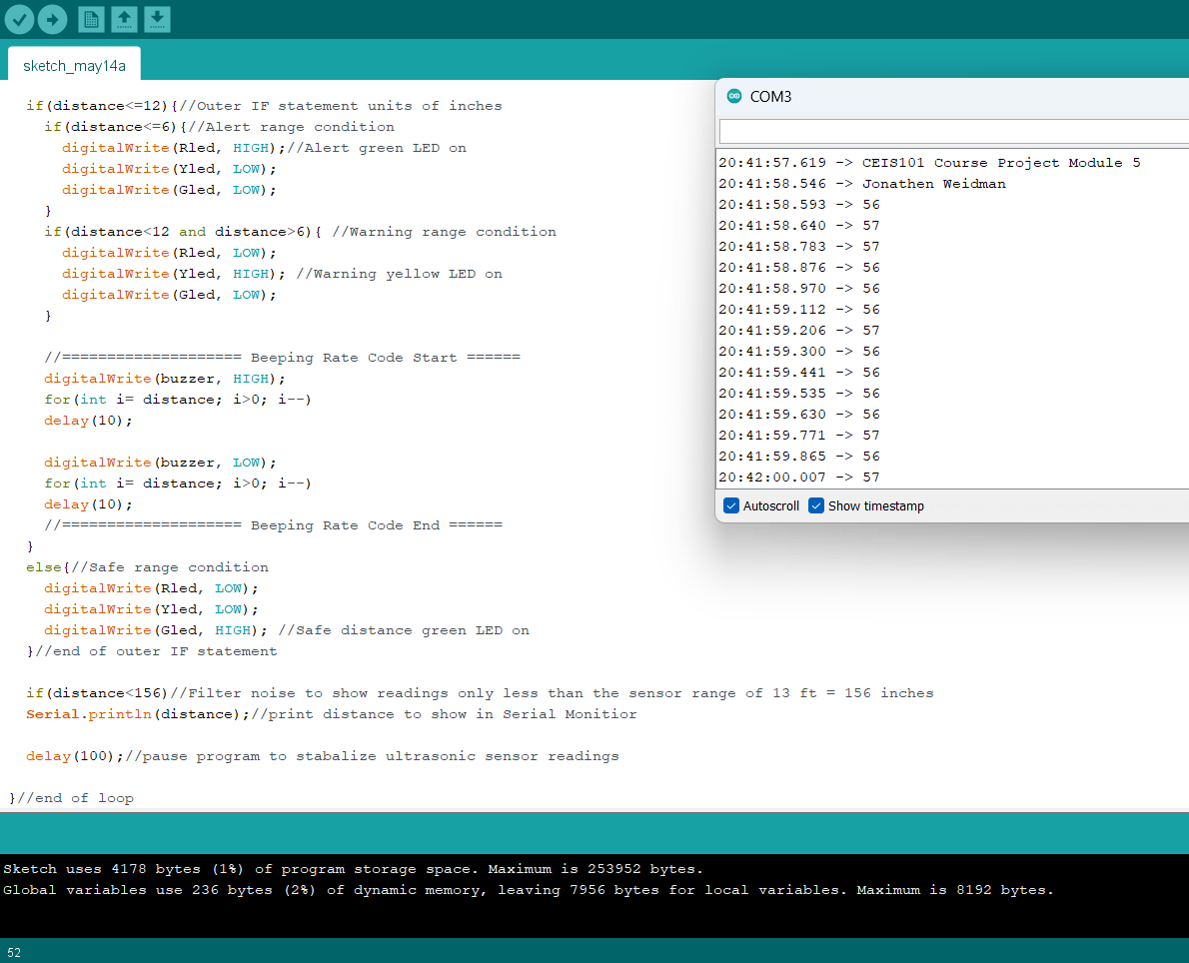
Arduino Code (screenshot)

Slide 21
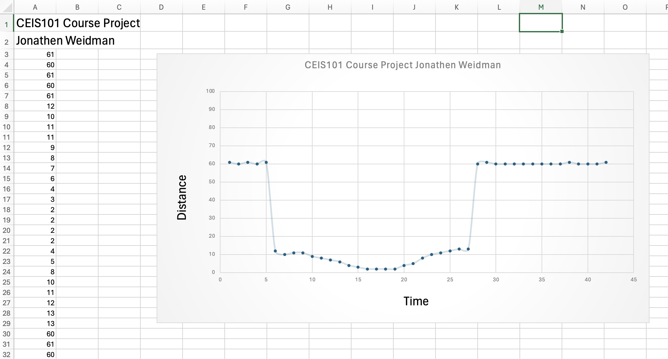
Plot of data (graph from Excel)

Slide 22
Module 6 Overview
In this portion, I was tasked with adding automation to the mix alongside the security. I added the blue LED and a photocell to achieve this automation.
This is an automated light the turns on when the lights are out which the light level is detected by the photocell. When a bright light gets closer it will automatically turn off the blue LED.
It’s almost like a solar powered garden light in a way where the sun turns off the light and charges the battery. In this case there is no battery to charge though.
In the serial monitor you can see it notify us when the LED is turned on because the light wasn’t strong enough for the photocell to pick up.

Slide 23
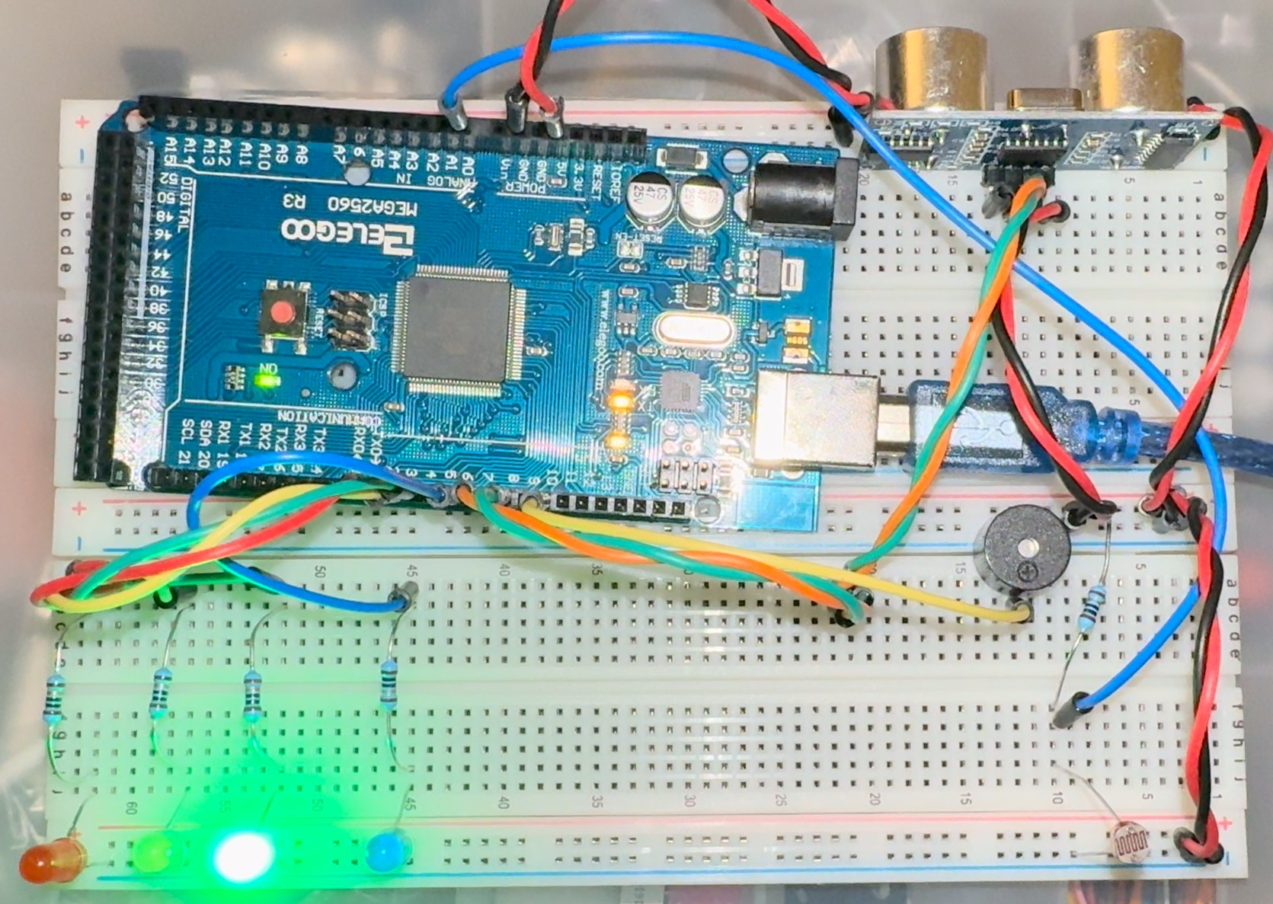
Circuit with automated LED off (picture)

Slide 24
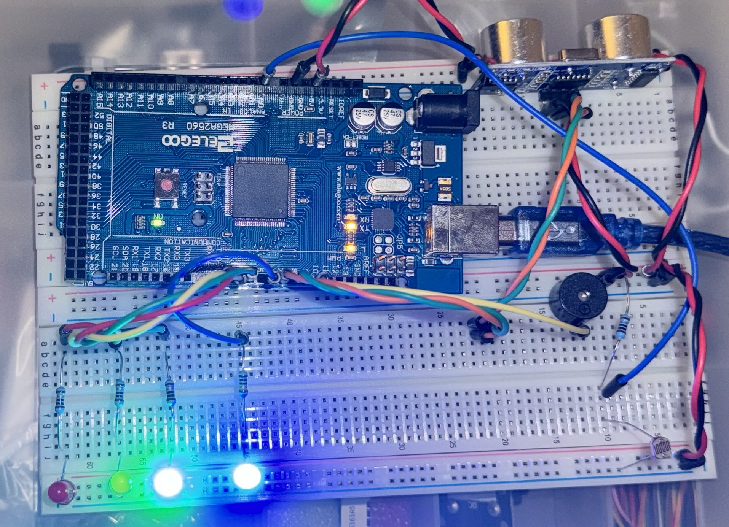
Circuit with automated LED on (picture)

Slide 25
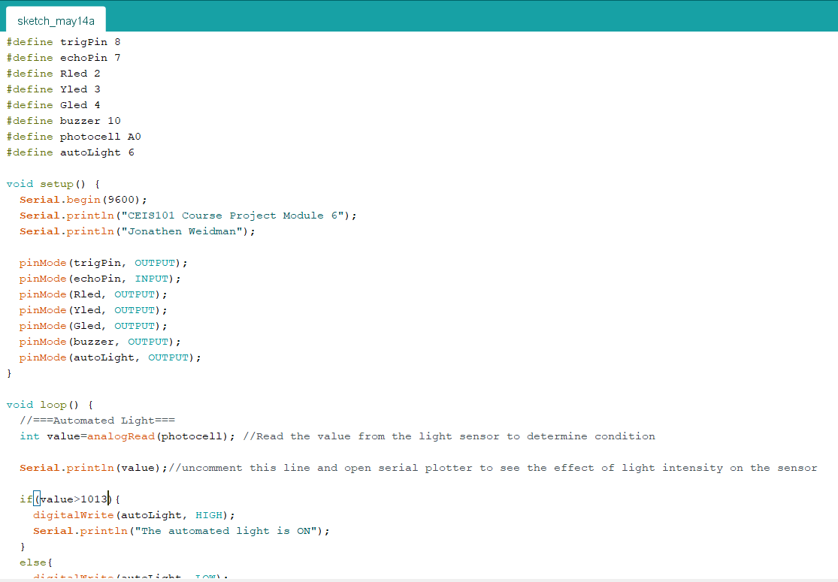
Arduino Code (screenshot)

Slide 26
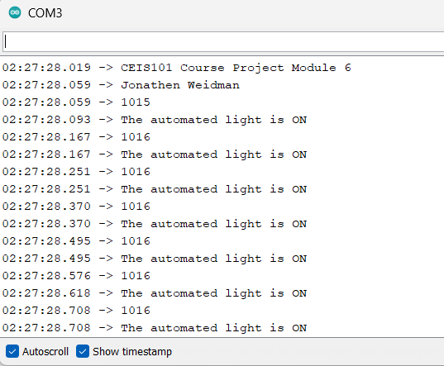
Serial Monitor (screenshot)

Slide 27
Challenges/Lessons Learned
When I first started this project, I struggled to find the correct parts that I needed. Some I couldn’t find because they were so small. I eventually became accustomed to the parts as the were listed inside the IoT kit with the names and images.
I had trouble keeping the breadboard neat and tidy to keep track of everything until I saw a professor use two breadboards instead of one and had better cable management than I did which is where I got the idea for my wires in module 6.
I made some mistakes when writing the code instead of copying and pasting so I could get used to doing the code myself for future career choices.
I overcame all these obstacles by attending my live sessions and emailing with my professor as well as getting help and advice from my peers.

Slide 28
Career Skills
I developed some great skills that I hope I can use in my future career in tech. I learned how to properly wire an IoT device and connect it to a program to accomplish the task I need it to.
In this course I also learned how to troubleshoot problems that had arose when programming the device and learned the importance of resistors, so I don’t burn any part of the device out.
I picked up on some better cable management habits to keep my device organized. I also learned the importance and how to secure my devices.

Slide 29
Conclusion
This course has filled me with so much knowledge on IoT devices and security. Even though this was an introduction class, I feel as though I am ready to get started in this industry.
This class was very useful in learning that security is not just important on the network or the device itself but, physical security is just as important.
If anyone was able to have access to the device, it could cause a problem if they tried to switch something around with no knowledge of what the are doing.
This project has really taught me a great deal about designing, prototyping, and building all parts of an IoT device.

Slide 30
References
For this project I used the tools provided to me by the school. The PowerPoint deliverables to guide me throughout the process and primarily using site like Wikipedia and Reddit to help get answers to some of my questions when I hit a wall.
I always asked my peers for assistance when I struggled to figure out what I was doing wrong that I could get an aspect of my device to function as it shoul.

